Slide 1

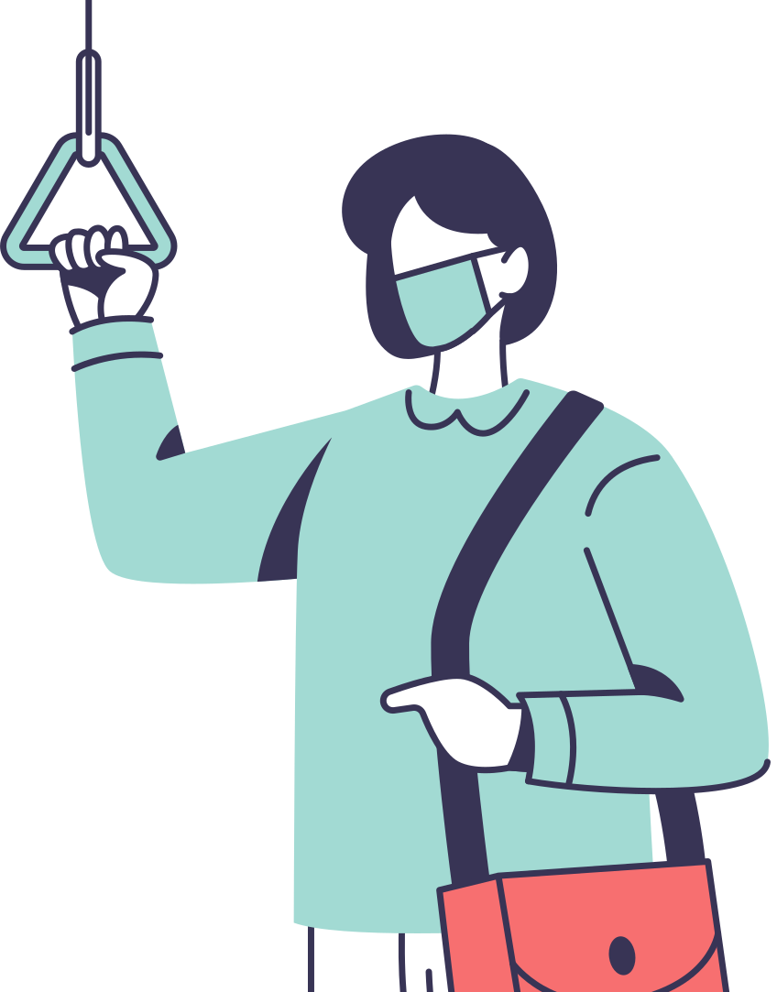

Real-time
TranspoReal-Time Face Mask Detection Using Deep Learning & OpenCV
By Lobna Rizk

Slide 2



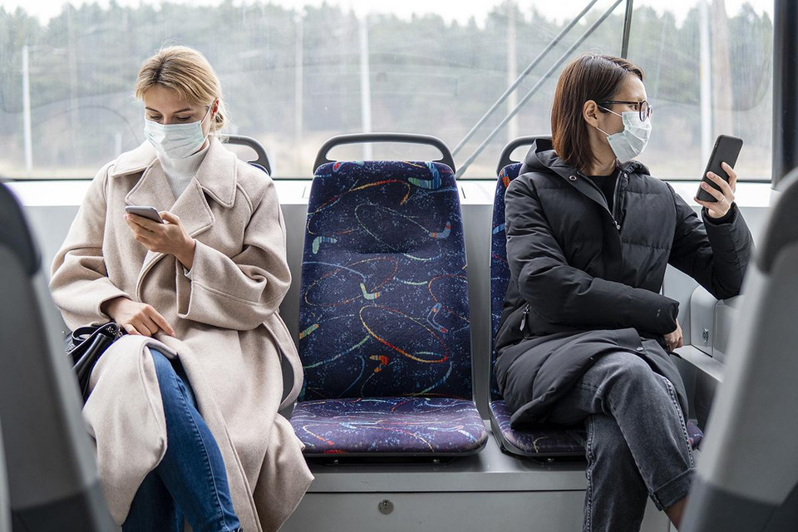

Dataset Selection
Used Kaggle's Mask or No Mask Dataset 🏆
Contains images of people with masks, without masks, and wearing masks incorrectly
Preprocessing:
Resized images to 224x224 pixels (MobileNetV2 input size)
Normalized pixel values (1/255.0)
Split data into Train (70%) | Validation (15%) | Test (15%)

Slide 3


Model Training (CNN – Deep Learning Approach)
Used a Convolutional Neural Network (CNN)
Base model: MobileNetV2 (pre-trained on ImageNet)
Why MobileNetV2? ⚡
✅ Lightweight
✅ Fast inference
✅ Well-suited for real-time applications
Fine-tuned with Softmax classifier for 3 classes
After training, saved the model as an .h5 file
This allows us to use the trained model outside the training environment

Slide 4



Real-Time Mask Detection with OpenCV
01
02
INTRODUCTION
PREVENTION
05
Open webcam
Detect faces using Haarcascade
PREVENTION
Draw bounding boxes with labels (Mask ✅, No Mask ❌, Incorrect ⚠️)
03
04
METHODOLOGY
CONCLUSIONS
reprocess face image (resize, normalize, reshape)
Pass face through the trained model to predict mask status

Slide 5



THANKS!
Do you have any questions?
Lobnarizk2003@gmail.com
CREDITS: This presentation template was created by Slidesgo, incluiding icons by Flaticon, and infographics & images by Freepik

